Slide 1
ANALYSIS OF SUBSPACE ALIGNMENT ALGORITHM
FOR DOMAIN ADAPTATION BHUMI GODIWALA

Slide 2
Table of Contents
Subspace Alignment Algorithm Overview
Subspace Alignment (SA) Algorithm
Research Rationale
Approach 1: Working with Synthetic Dataset
Approach 1: Results and Observations
Approach 2: Working with CaffeNet, GoogleNet, Surf Datasets
Approach 2: Results and Observations
Conclusion
References

Slide 3
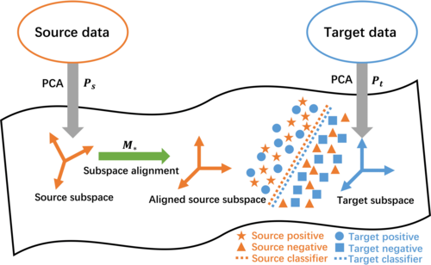
Subspace Alignment Algorithm Overview
The source and target domain data are projected to their corresponding subspaces by the PCA.
Subsequently, the source domain subspace data are aligned to the target domain subspace data by the transformation matrix M∗, resulting in the aligned source domain data.
A classifier will be applied to the aligned source domain data and the target domain data to predict the target labels.
Fig II. Illustration of Subspace alignment Algorithm [2]

Slide 4
Subspace Alignment (SA) Algorithm Overview
Subspace Alignment is a technique used in machine learning to align the subspaces spanned by different sets of features or representations.
It's particularly useful in domain adaptation and transfer learning scenarios. Here are some key characteristics of Subspace Alignment:
Domain Adaptation - Aligns source and target domain subspaces in machine learning
Linear Transformation - Finds a linear transformation for cross-domain subspace alignment.
Subspace Representation - Focuses on capturing data structure through subspaces.
Principal Component Analysis(PCA) - Uses PCA to identify and align principal components.
Unsupervised Learning - Applied in unsupervised or semi-supervised scenarios.
Covariate Shift Correction - Mitigates distributional discrepancies between domains.
Generalization across Domains - Improves model generalization from source to target domain.
Reduction of domain Gap - Minimizes statistical differences between domains.
Robustness to Noisy Data - Emphasizes robustness by focusing on underlying data structure.
Application in Feature Learning - Extends beyond domain adaptation to feature learning.

Slide 5
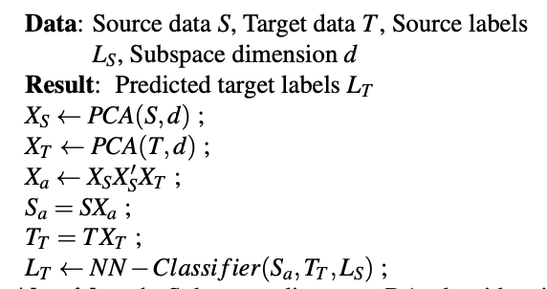
Subspace Alignment (SA) Algorithm
Fig III. Subspace alignment Algorithm [1]

Slide 6
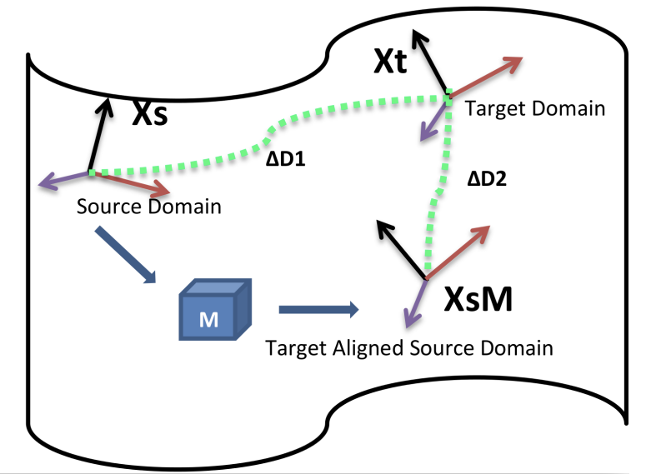
Research Rationale
While subspace alignment can be effective in certain scenarios, there are situations where it may not work as well.
The performance can be affected due to various factors like non-linearity, high dimensionality of data,limited label information, computational complexity, inadequate hyperparameter tuning and others
Thus, analysing the algorithm for classification problem.
Fig 1. Subspace alignment Algorithm [1]

Slide 7
Approach 1: Working with Synthetic Dataset
Initial Approach consisted of implementing the SA algorithm using a custom generated synthetic dataset.
The dataset considered following assumptions:
Considered a binary classification problem
Both source and target data is Independent and identically distributed random variables
Balanced normal distributions for both source and target data with 2 features
Covariances of source and target data is symmetric positive definite
Source and Target data contain 100 samples with 50 samples belonging to each class
P(y) is same for both source and target i.e P(y) = 0.5

Slide 8
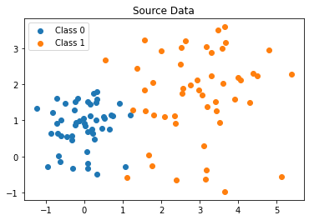
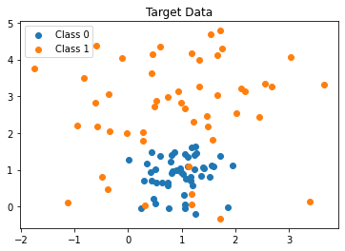
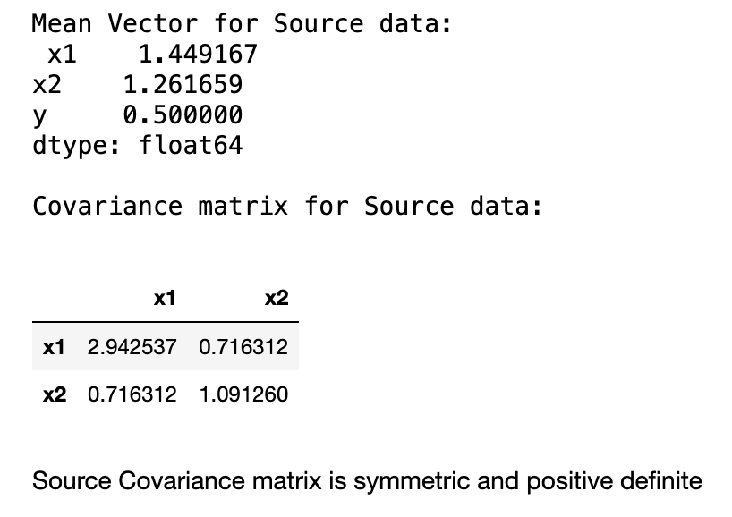
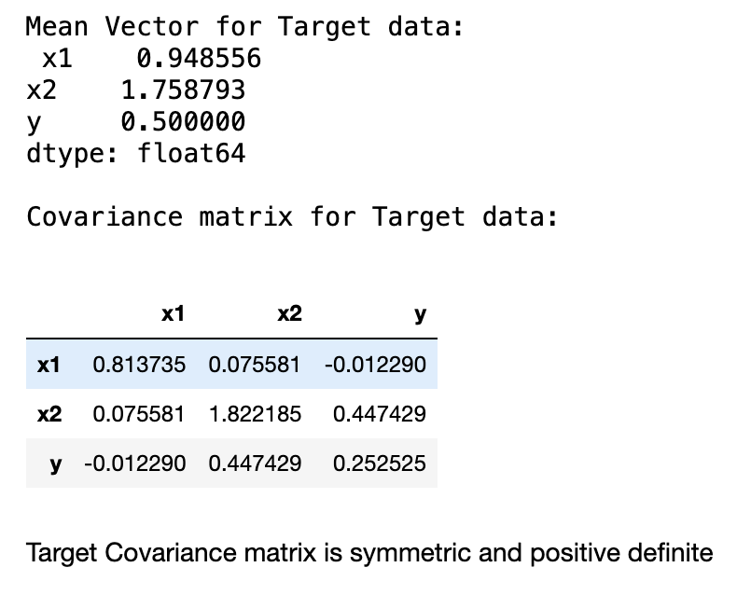
Approach 1: Working with Synthetic Dataset
Fig III. Source & Target Distributions

Slide 9
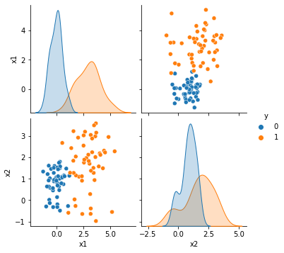
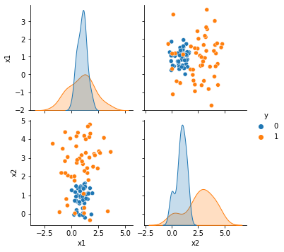
Approach 1: Working with Synthetic Dataset
Fig IV. Pairplot for Source Data
Fig V. Pairplot for Target Data

Slide 10
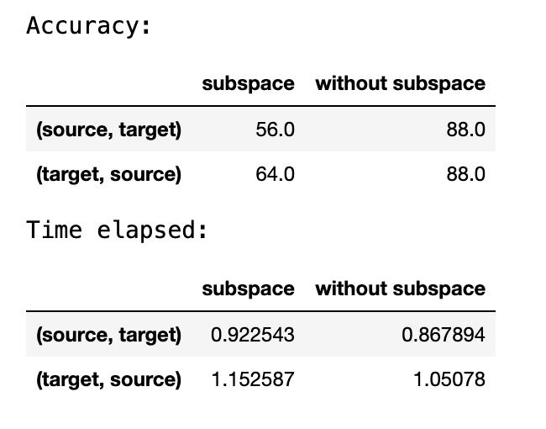
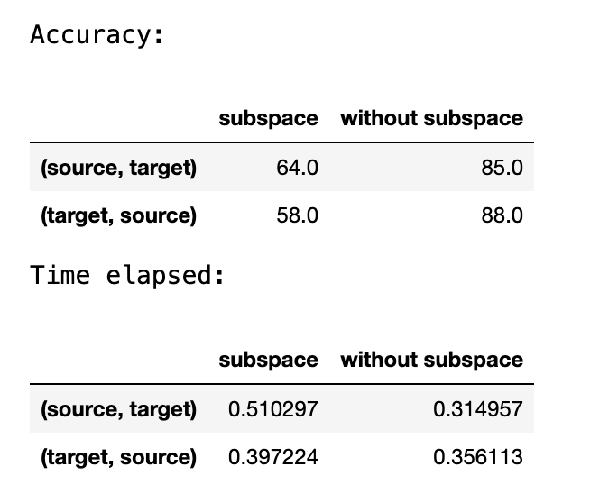
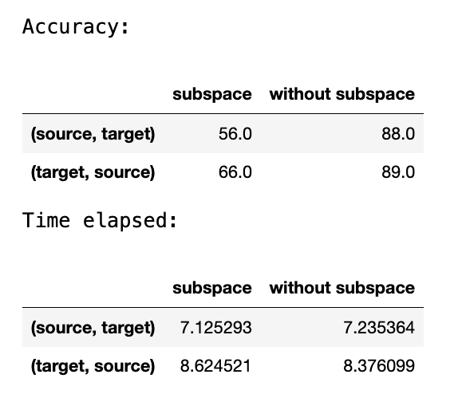
Approach 1: Results and Observations
Experimented using different classifiers like k-Nearest Neighbors, Random Forest, Support Vector Machine(SVM), Gaussian Naive Bayes, and Ridge Classifier
Compared the results using Accuracy as the performance metric to verify the binary classification accuracy results
We observed that the results varied for different combinations of source and target.
Overall the performance accuracy for subspace was less than that without subspace in case of all classifiers which contradicted the results from the research paper.
Accuracies for SVM, Gaussian Naive Bayes, k-Nearest Neighbours respectively(from left to right)

Slide 11
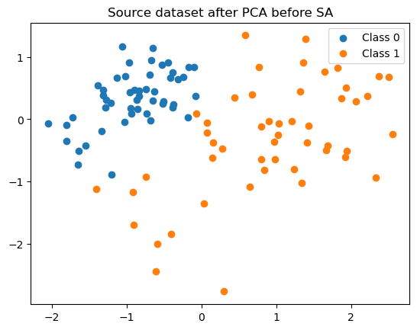
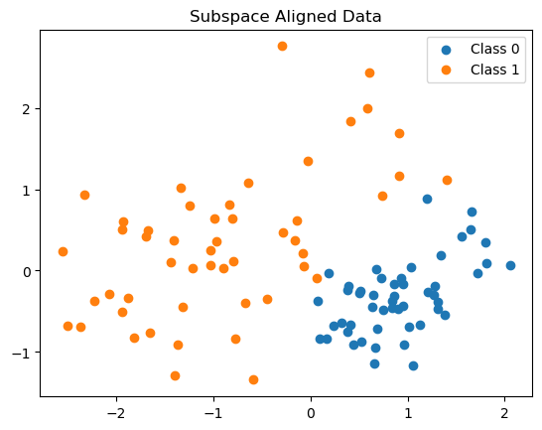
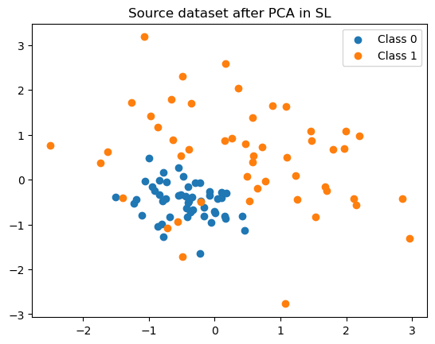
Approach 1: Results and Observations
Fig VI. Subspace Alignment from Source Data -> Target Data

Slide 12
Approach 2: Working with CaffeNet, GoogleNet, Surf Datasets
Implemented the SA Algorithm on the datasets used in the research paper[1].
Worked with CaffeNet, GoogleNet and Surf datasets
The key characteristics of these datasets are:
Every dataset had 10 classes for classification task
All the datasets consisted of data collected from different sources namely dslr, webcam and Amazon
For a single caffeNet dataset subspace alignment was applied considering dslr as source and webcam as target or vice versa
Similarly the SA Algorithm was tested for GoogleNet and Surf datasets
Caffenet comprised of 4096 features, GoogleNet comprised of 1024 features and Surf dataset comprised of 800 features
The SA algorithm was implemented using PCA with 13 components and for visualization the results were plotted using PCA with 2 components

Slide 13
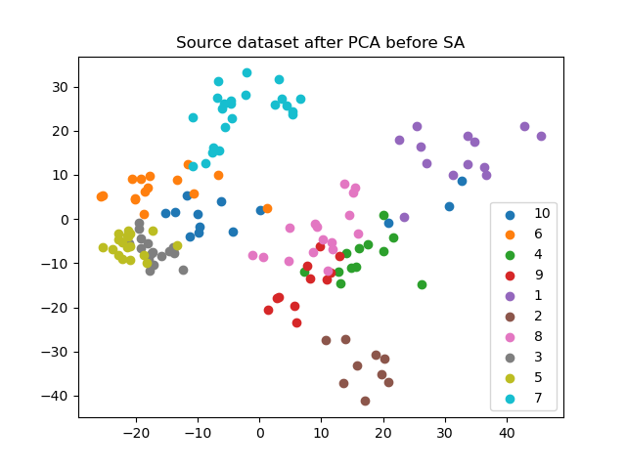
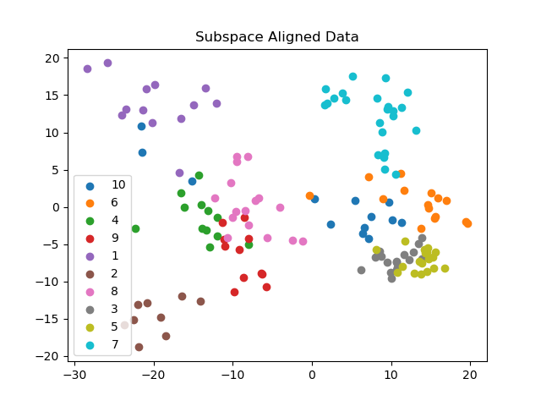
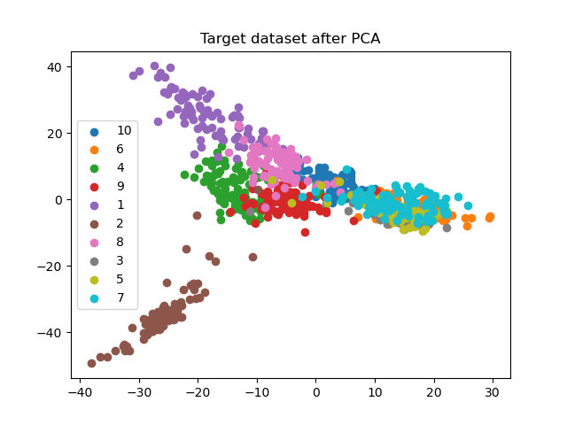
Approach 2: Working with CaffeNet, GoogleNet, Surf Datasets
Fig VII. Caffe Dataset - Scatter Plots with PCA(n=2), 50% random sampling of source data

Slide 14
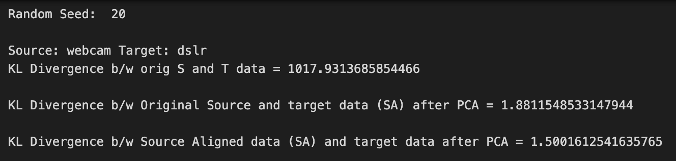
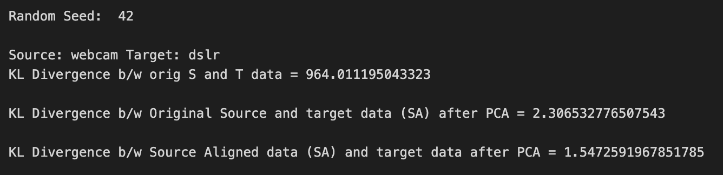
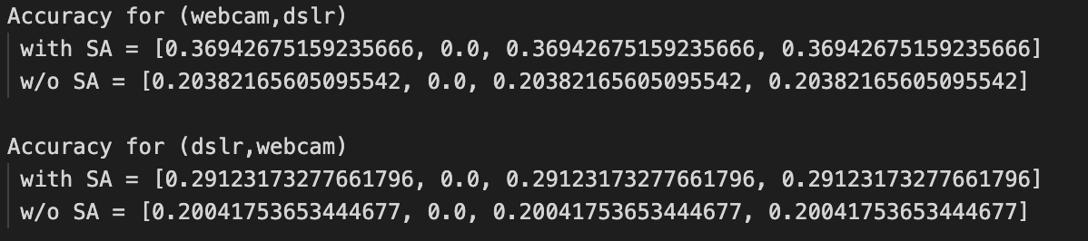
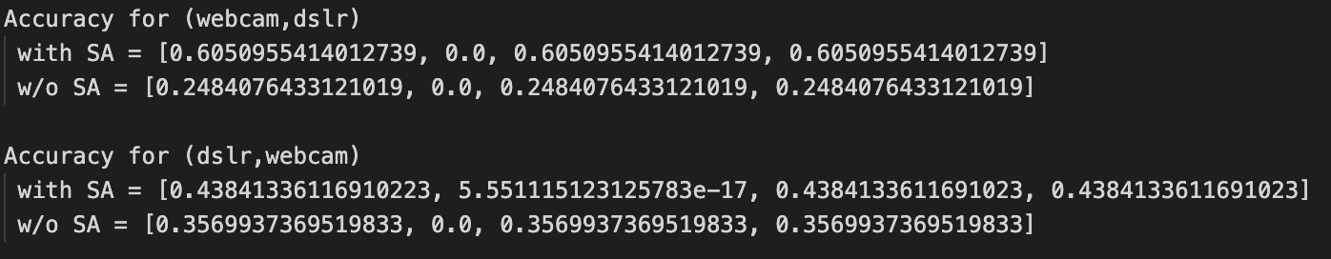
Approach 2: Working with CaffeNet, GoogleNet, Surf Datasets
Fig IX. Caffe Dataset - PCA(n=2) - 50% random sampling of source data,
Accuracy = [Mean Accuracy, Std Deviation Accuracy, Minimum Accuracy, Maximum Accuracy],
KL Divergence between original source and target data, subspace aligned data with target data

Slide 15
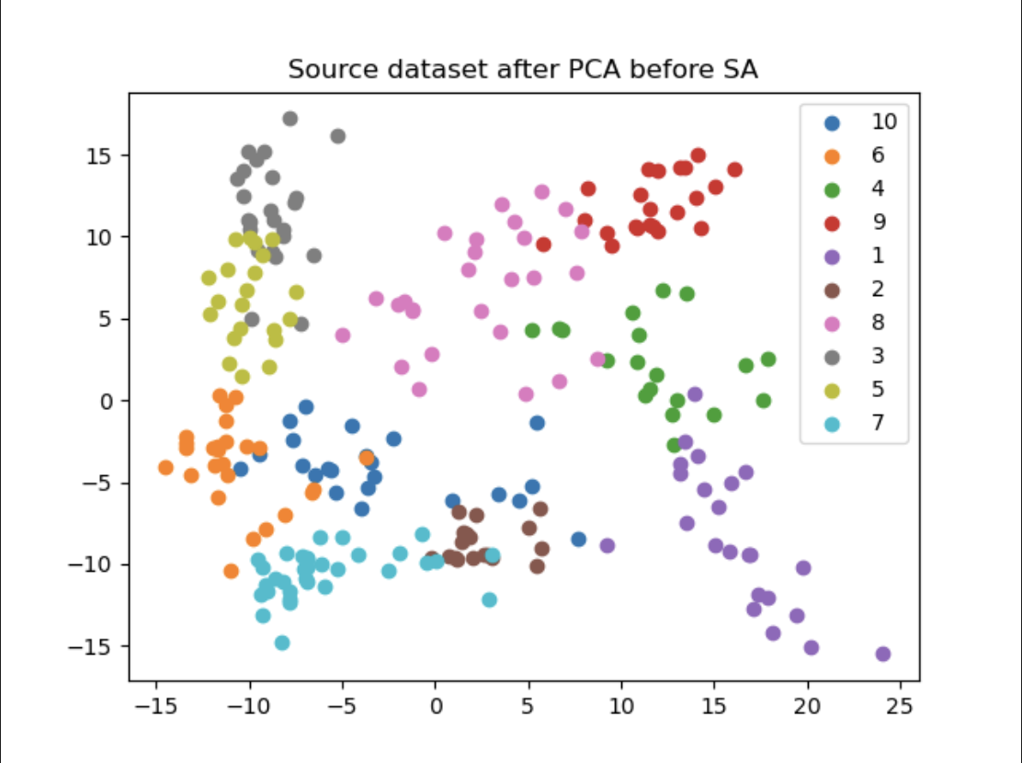
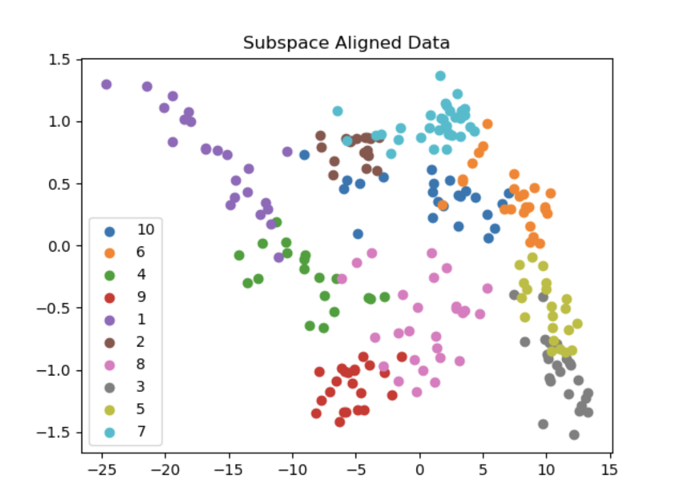
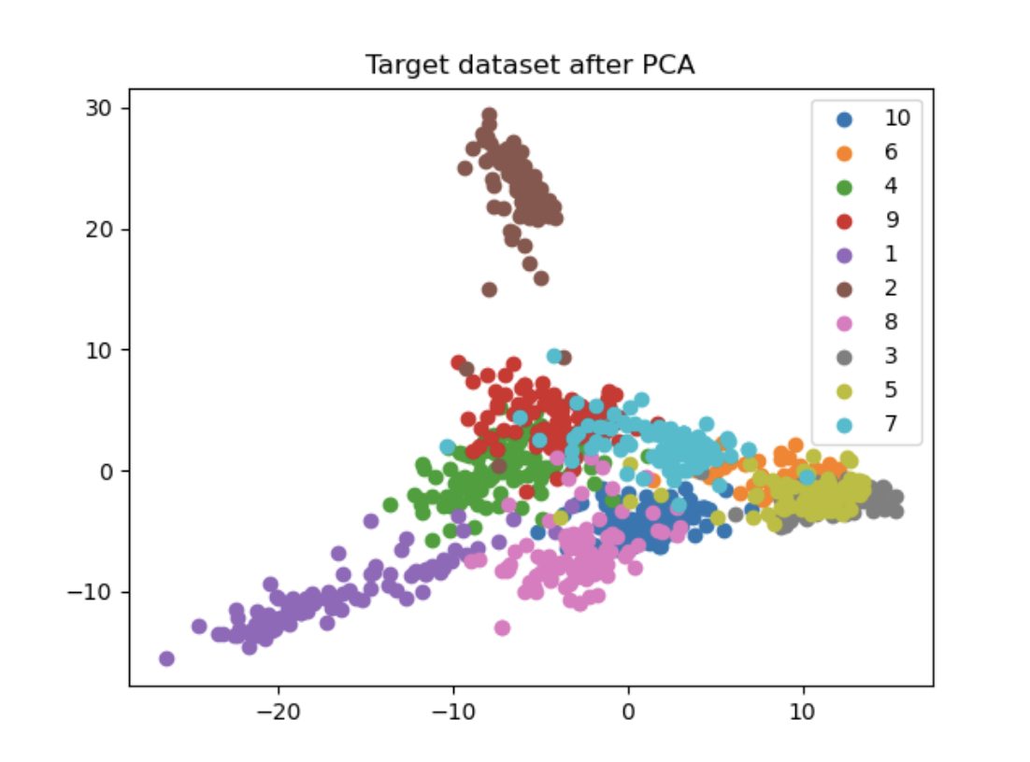
Approach 2: Working with CaffeNet, GoogleNet, Surf Datasets
Fig VII. GoogleNet Dataset - Scatter Plots with PCA(n=2), 80% random sampling of source data

Slide 16
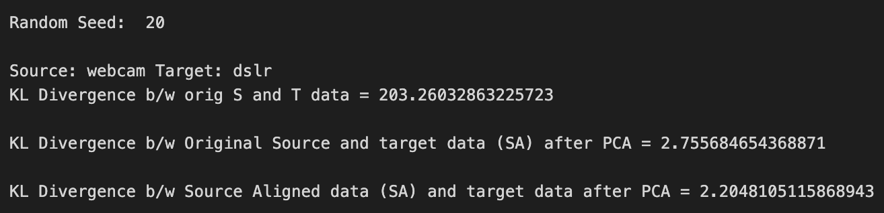
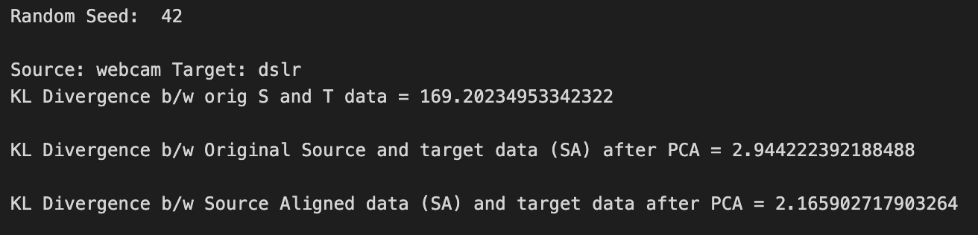
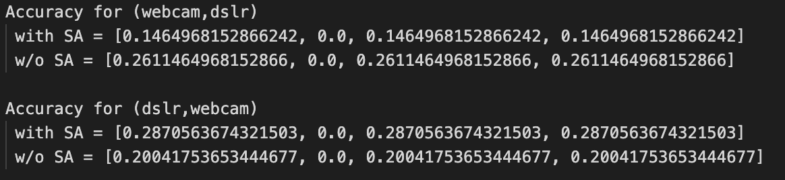
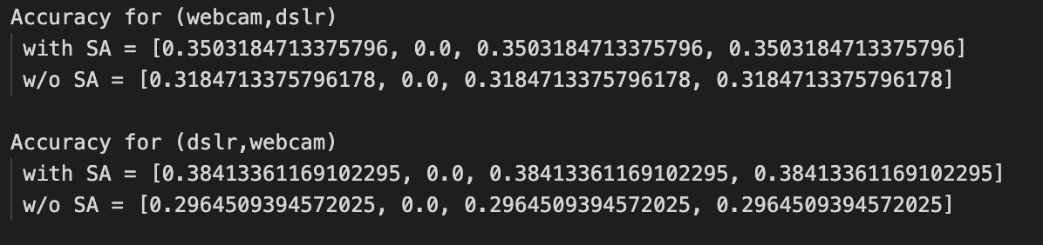
Approach 2: Working with CaffeNet, GoogleNet, Surf Datasets
Fig IX. GoogleNet Dataset - PCA(n=2) - 80% random sampling of source data,
Accuracy = [Mean Accuracy, Std Deviation Accuracy, Minimum Accuracy, Maximum Accuracy],
KL Divergence between original source and target data, subspace aligned data with target data

Slide 17
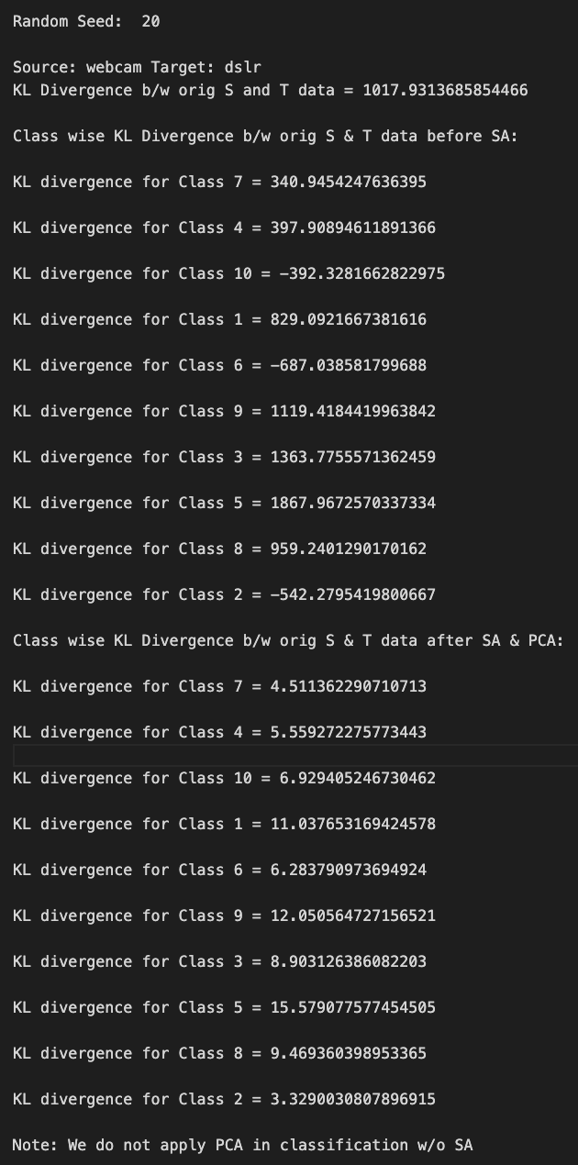
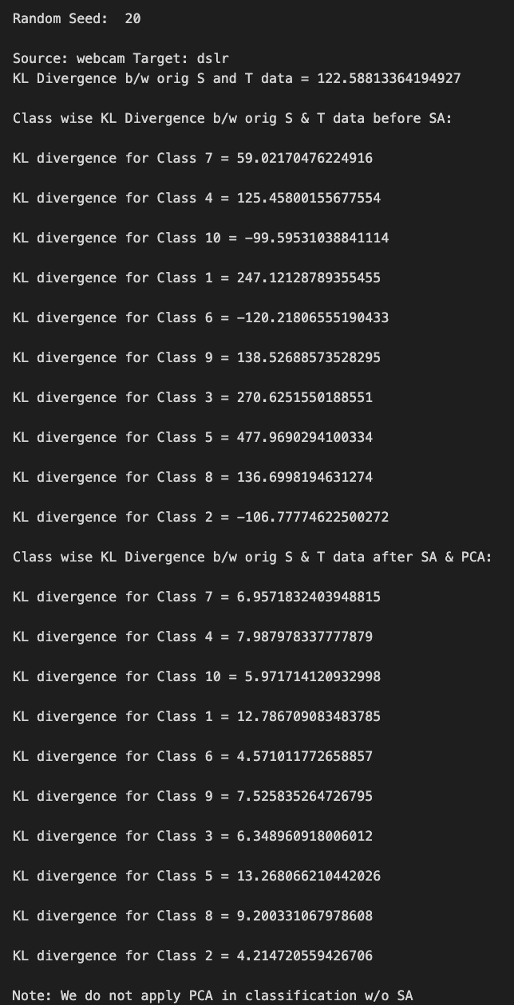
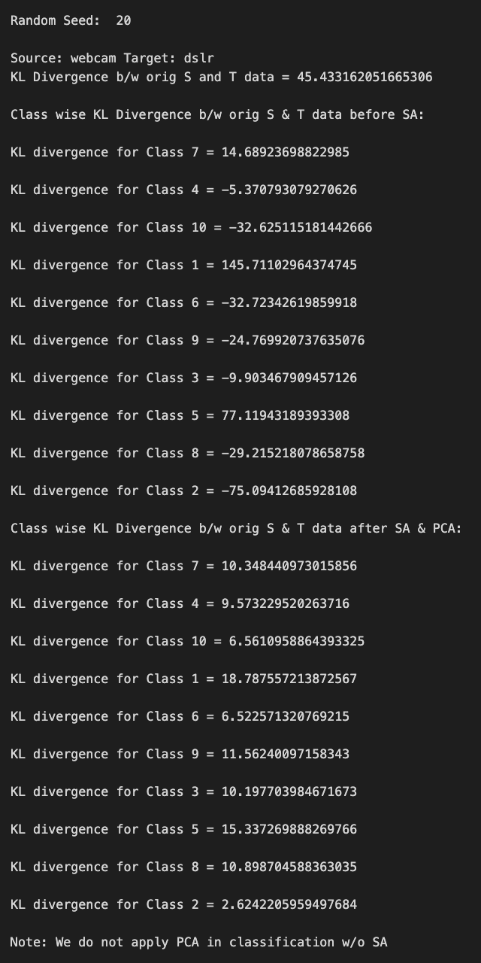
Approach 2: Working with CaffeNet, GoogleNet, Surf Datasets
Fig VII. Class Wise KL Divergence drops for Caffe, GoogleNet and Surf Datasets respectively(from left to right)

Slide 18
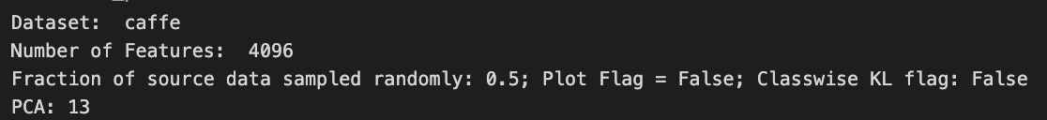
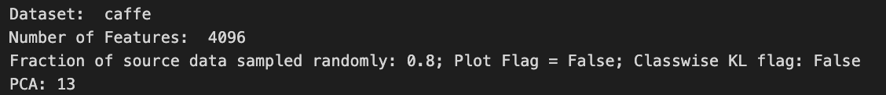

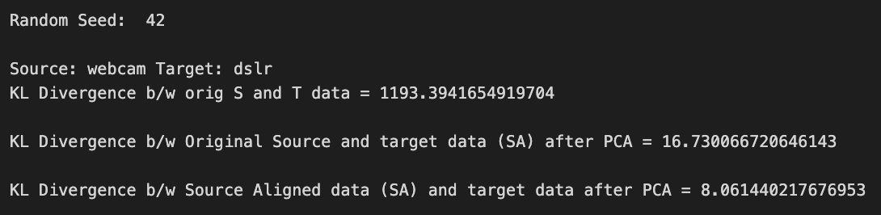
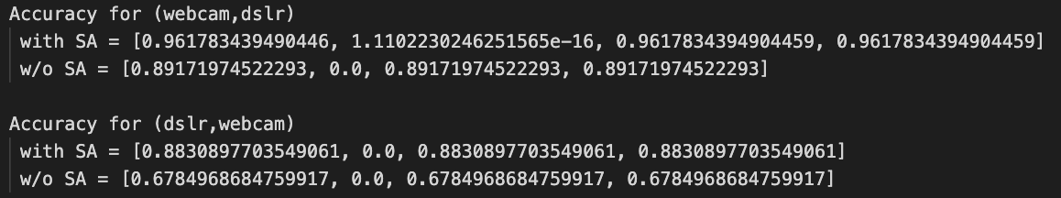
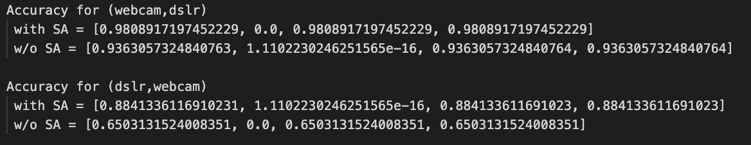
Approach 2: Working with CaffeNet Dataset
Fig IX. GoogleNet Dataset - PCA(n=13) - 50% and 80% random sampling of source data respectively,
Accuracy = [Mean Accuracy, Std Deviation Accuracy, Minimum Accuracy, Maximum Accuracy],
KL Divergence between original source and target data, subspace aligned data with target data

Slide 19
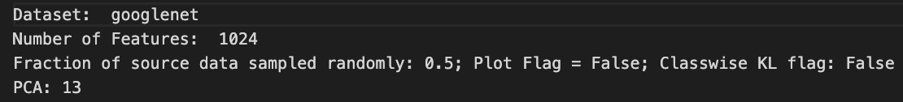
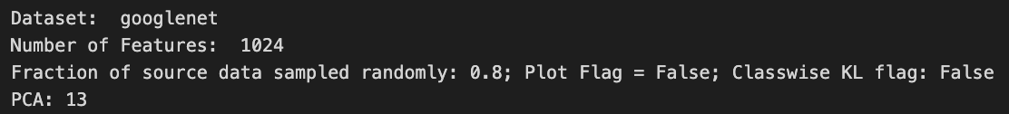


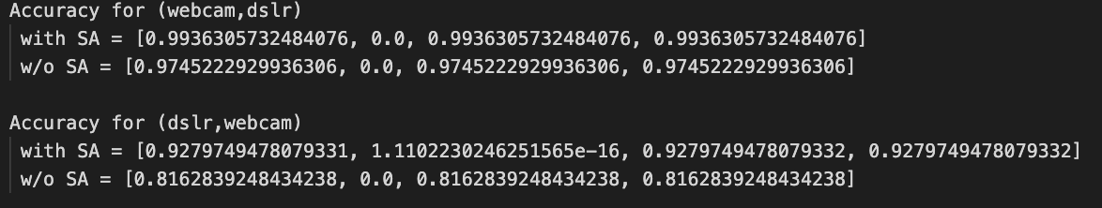
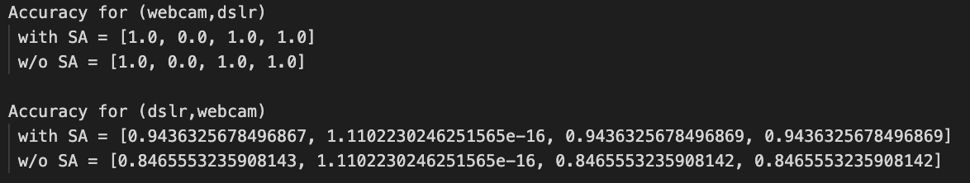
Approach 2: Working with GoogleNet Dataset
Fig IX. GoogleNet Dataset - PCA(n=13) - 50% and 80% random sampling of source data respectively,
Accuracy = [Mean Accuracy, Std Deviation Accuracy, Minimum Accuracy, Maximum Accuracy],
KL Divergence between original source and target data, subspace aligned data with target data

Slide 20
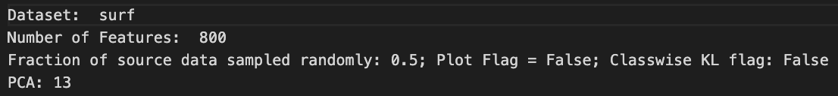
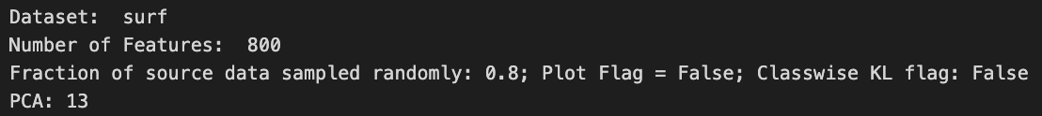
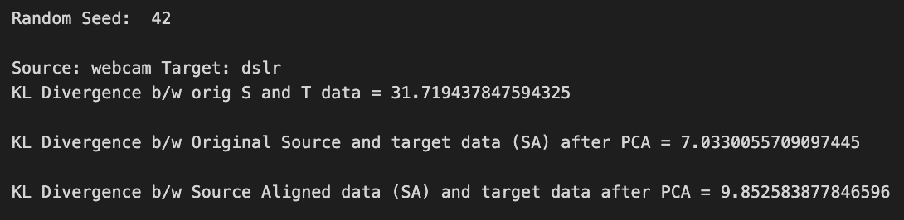

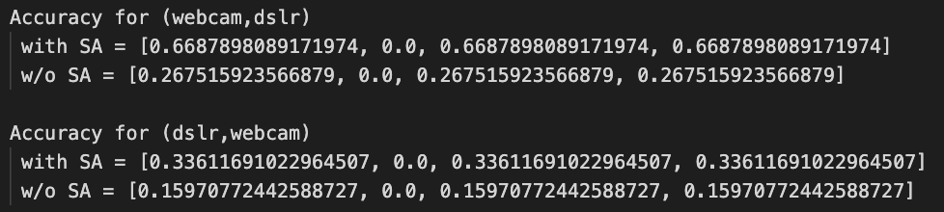
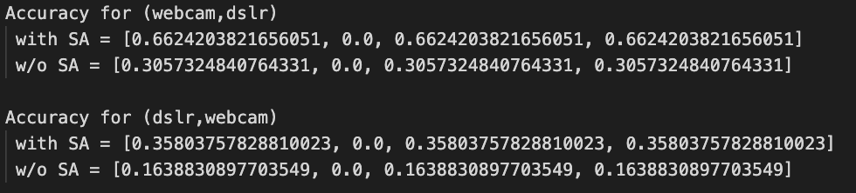
Approach 2: Working with Surf Dataset
Fig IX. Surf Dataset - PCA(n=13) - 50% and 80% random sampling of source data respectively,
Accuracy = [Mean Accuracy, Std Deviation Accuracy, Minimum Accuracy, Maximum Accuracy],
KL Divergence between original source and target data, subspace aligned data with target data

Slide 21
Approach 2: Results and Observations
The SA algorithm was tested using random sampling from the source dataset and testing on the target dataset after applying SA algorithm. The fraction for random sampling used is variable and the algorithm has been tested with fraction ranging from 10% to 80% random sampling
Experimented for various values of random seed
Experimented using different classifiers like k-Nearest Neighbors
Compared the results using Accuracy, overall KL divergence[3] between datasets and classwise KL divergence as the performance metrics to verify the 10 class classification accuracy results.
The results varied for different combinations of source and target, different combinations of fraction of random sampling from source data and random seed
Overall the performance accuracy for subspace was greater than that without subspace in case of all classifiers which reflected the same results as that from the research paper[1]
Randomly sampling the source dataset from anything above 75-80%, gives a convergence in accuracy for different values of random seeds.

Slide 22
Conclusions
Efficient domain adaptation is contingent on datasets being sufficiently large and feature-rich.
Sensitivity of accuracy to random sampling fractions underscores the importance of strategic data selection.
Application of Subspace Alignment and PCA plays a pivotal role in minimizing KL Divergence, indicating successful alignment between source and target datasets.
Noticeable reduction in KL Divergence for data specific to each class signifies the algorithm's effectiveness in adapting to different data characteristics.

Slide 23
References
[1] Subspace Alignment For Domain Adaptation Basura Fernando, Amaury Habrard, Marc Sebban, Tinne Tuytelaars
[2] Quantum subspace alignment for domain adaptation, Xi He, Phys. Rev. A 102, 062403 – Published 2 December 2020
[3] Pérez-Cruz, F. Kullback-Leibler divergence estimation of continuous distributions IEEE International Symposium on Information Theory, 2008.
[4] KL Divergence for Multivariate Samples

